Slide 1
Call Centre Dashboard
“This dashboard provides the detailed analysis of the call Centre company which helps the industry to make informed decisions based on the provided insights through dashboards”

Slide 2
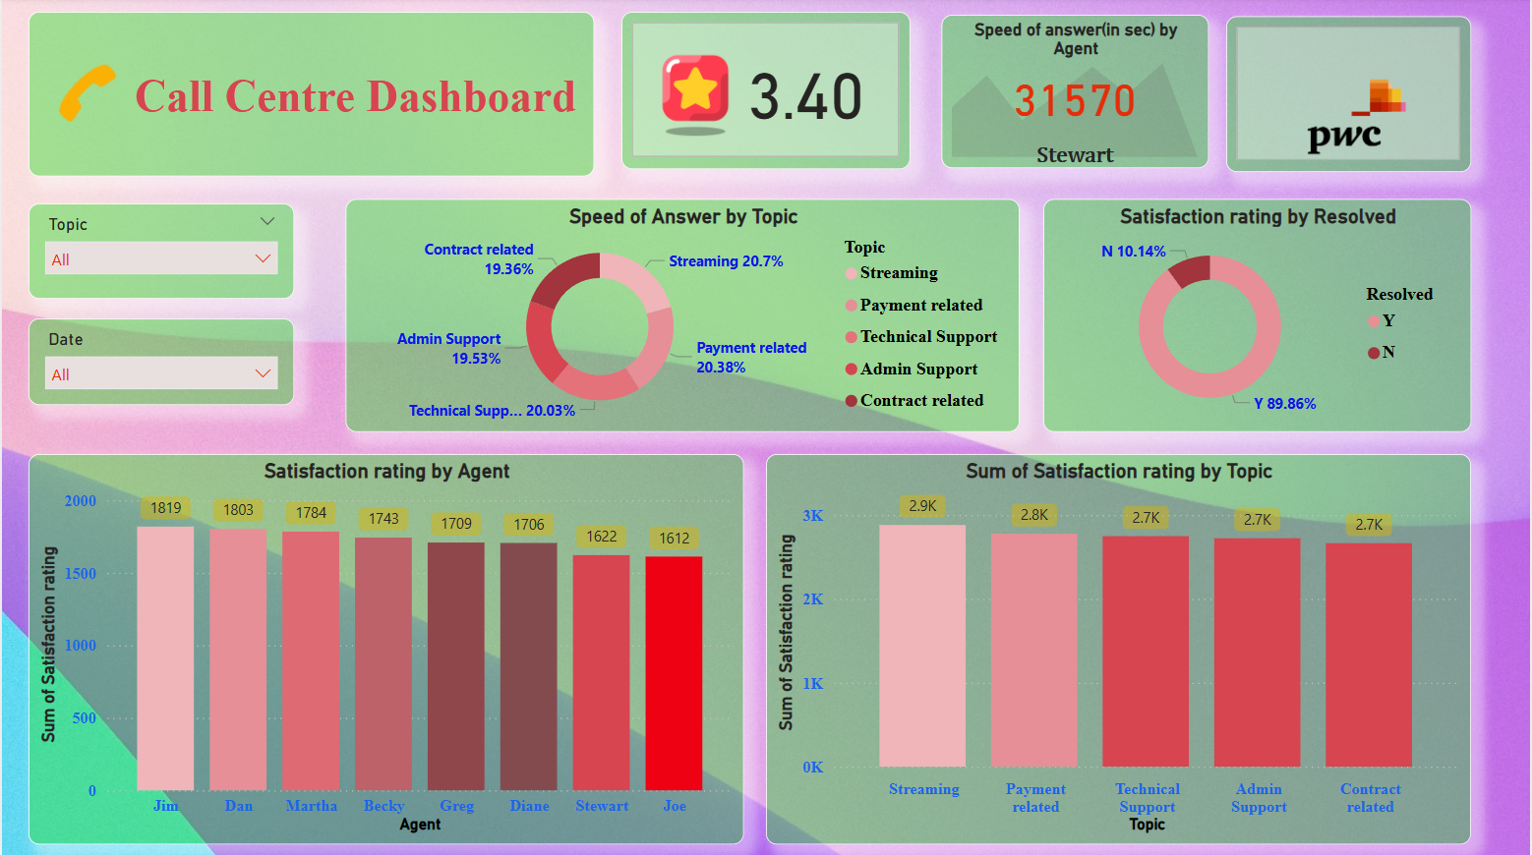
DASHBOARD

Slide 3
Key Insights:
We have found that the call centre company has answered the customers mostly related to the “Streaming Queries”, i.e 20.7%.
We Found that most customers have completely resolved their issues i.e 89.86%.
Also Find out the Performance of Staff by finding out the top 10 staff person with the top ratings, we got the name such as Jim,Dan,Martha,Becky,greg,etc.
Also Find out the Satisfaction Rating by Topics such as Streaming,Payment related,Technical support,etc and we found out that highest satisfaction rating goes to the Streaming Category.

Slide 4
Thank You

